Slide 1

Neural Networks and the Universal Approximation Theorem

Slide 2
Brief of what we have done till now
Neural Network Components
Inputs: Inputs are the set of values for which we need to predict the output value. They can be viewed as features or attributes in a dataset.
Weights: weights are the real values that are associated with each feature which tells the importance of that feature in predicting the final value. (we will know more about in this article)
Bias: Bias is used for shifting the activation function towards left or right, it can be referred to as a y-intercept in the line equation. (we will know more about this in this article)
Summation Function: The work of the summation function is to bind the weights and inputs together and find their sum.
Activation Function: It is used to introduce non-linearity in the model.

Slide 3
Brief of what we have done till now
A neural network is simply a collection of Neurons(also known as activations), that are connected through various layers. It attempts to learn the mapping of input data to output data, on being provided a training set.
The training of the neural network later facilitates the predictions made by it on a testing data of the same distribution. This mapping is attained by a set of trainable parameters called weights, distributed over different layers.
The weights are learned by the backpropagation algorithm whose aim is to minimize a loss function.
A loss function measures how distant the predictions made by the network are from the actual values. Every layer in a neural network is followed by an activation layer that performs some additional operations on the neurons.

Slide 4
The Universal Approximation Theorem
Mathematically speaking, any neural network architecture aims at finding any mathematical function y= f(x) that can map attributes(x) to output(y).
The accuracy of this function i.e. mapping differs depending on the distribution of the dataset and the architecture of the network employed.
The function f(x) can be arbitrarily complex.
The Universal Approximation Theorem tells us that Neural Networks has a kind of universality i.e. no matter what f(x) is, there is a network that can approximately approach the result and do the job! This result holds for any number of inputs and outputs.

Slide 5
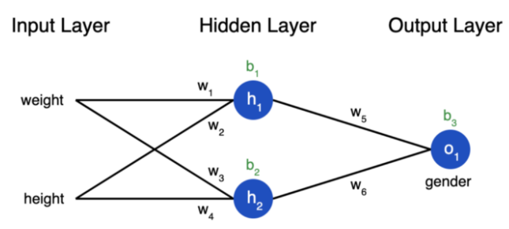
The Universal Approximation Theorem
If we observe the neural network, considering the input attributes provided as height and width, our job is to predict the gender of the person.
If we exclude all the activation layers from the example network, we realize that h₁ is a linear function of both weight and height with parameters w₁, w₂, and the bias term b₁. Therefore mathematically,
h₁ = w₁*weight + w₂*height + b₁
Similarily,
h2 = w₃*weight + w₄*height + b₂

Slide 6
The Universal Approximation Theorem
Going along these lines we realize that o1 is also a linear function of h₁ and h2, and therefore depends linearly on input attributes weight and height as well.
This essentially boils down to a linear regression model. Does a linear function suffice at approaching the Universal Approximation Theorem? The answer is NO. This is where activation layers come into play.
An activation layer is applied right after a linear layer in the Neural Network to provide non-linearities.
Non-linearities help Neural Networks perform more complex tasks.

Slide 7
The Universal Approximation Theorem
An activation layer operates on activations (h₁, h2 in this case) and modifies them according to the activation function provided for that particular activation layer.
Activation functions are generally non-linear except for the identity function. Some commonly used activation functions are ReLu, sigmoid, softmax, etc.
With the introduction of non-linearities along with linear terms, it becomes possible for a neural network to model any given function approximately on having appropriate parameters(w₁, w₂, b₁, etc in this case). The parameters converge to appropriateness on training suitably.

Slide 8
The Universal Approximation Theorem
An activation layer operates on activations (h₁, h2 in this case) and modifies them according to the activation function provided for that particular activation layer.
Activation functions are generally non-linear except for the identity function. Some commonly used activation functions are ReLu, sigmoid, softmax, etc.
With the introduction of non-linearities along with linear terms, it becomes possible for a neural network to model any given function approximately on having appropriate parameters(w₁, w₂, b₁, etc in this case). The parameters converge to appropriateness on training suitably.

